Slide 1
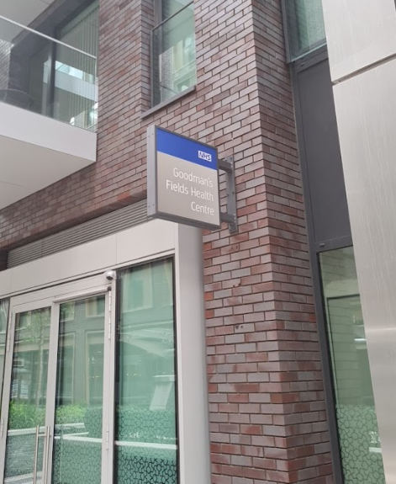
GOODMAN’S FIELDS
MEDICAL practice
Patient Participation Group
July 2022

Slide 2
What is a PPG?
A Patient Participation Group works alongside the practice to:
Present patient’s outlook on Practice led Services
Contribute to the continuous improvement of Practice Services
Strengthen communication between the practice and its patients
Encourage patients to take more responsibility for their health, wellbeing & wider community
Provide practical support and assist in implementing change
Gentle reminder that this meeting is not about complaints or personal issues

Slide 3
Advantages of PPG
The practice will be able to plan services jointly with patients
Help patients with non-medical and social care issues
Get help from patients to meet targets and objectives
Get closer to the community for whom we care for
Have a forum to voice ideas and concerns

Slide 4
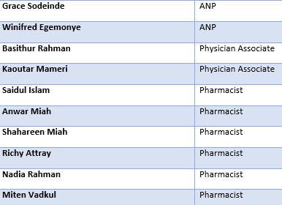
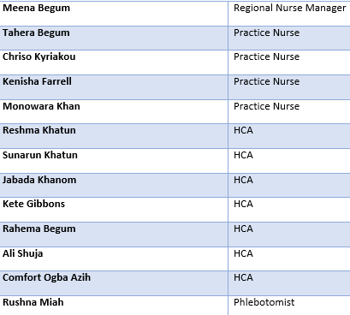
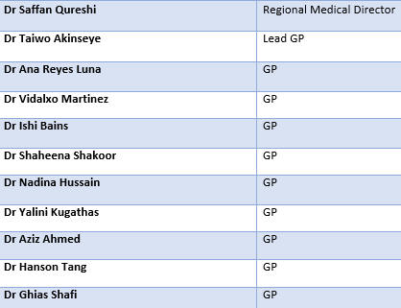
MEET THE CLINICAL TEAM
Total Allied Health Professionals: 10
Total GP’s: 11
Total Nursing staff: 13

Slide 5
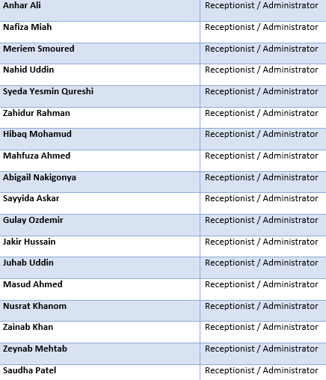
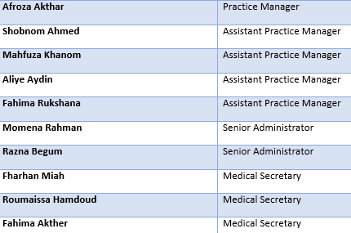
MEET THE ADMIN TEAM

Slide 6
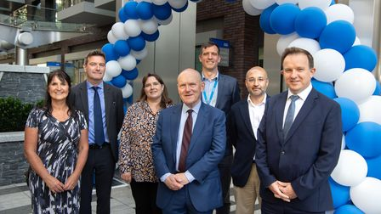
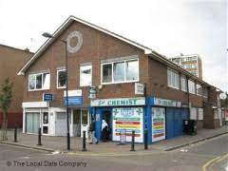
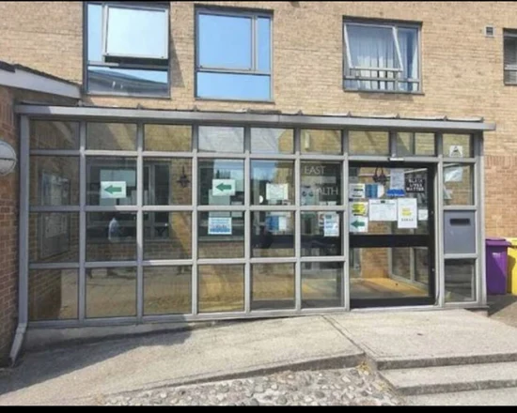
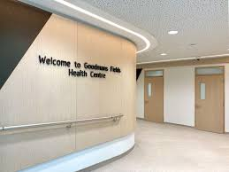
Our journey through changes
- Taking over East One in 2020
- Merge in July 2021
- Relocation of two sites in September 2021

Slide 7
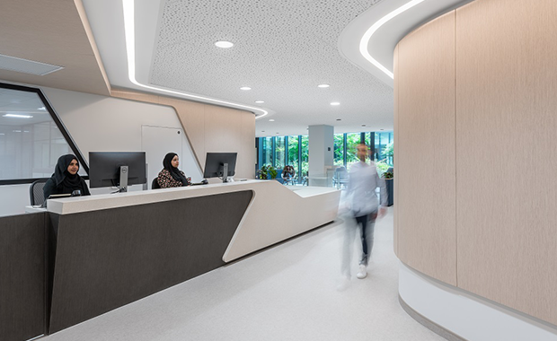
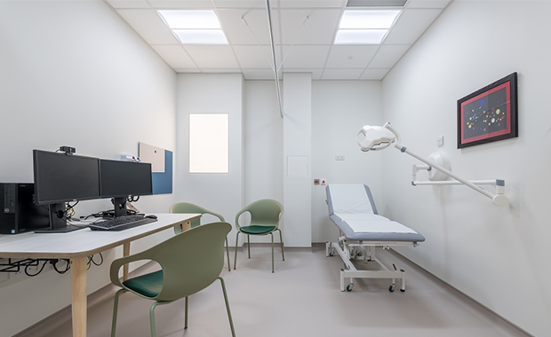
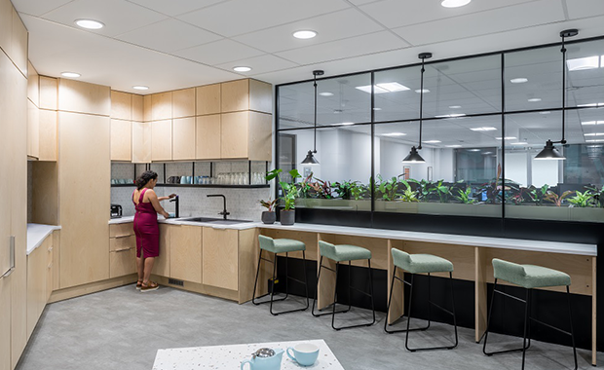
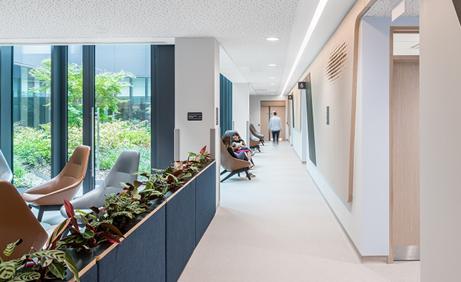
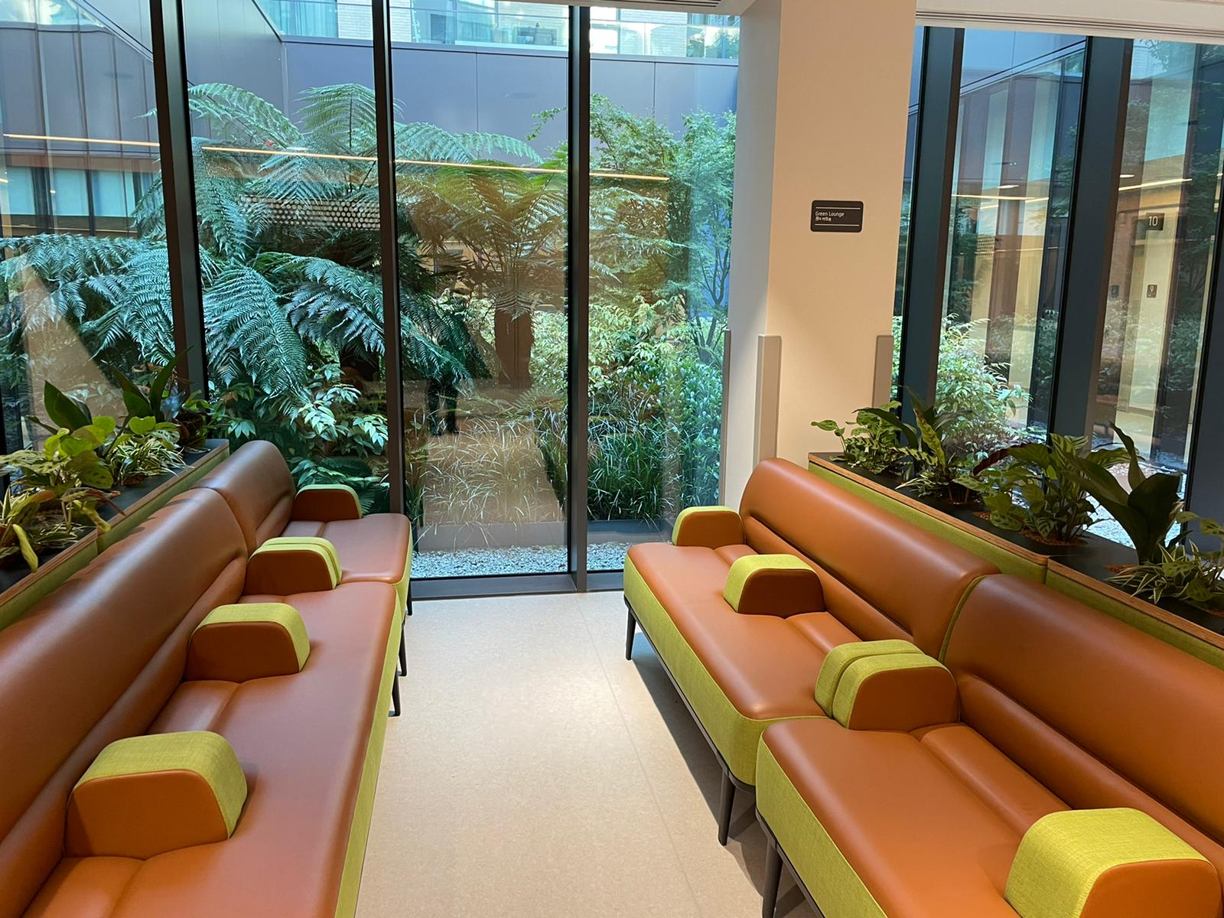
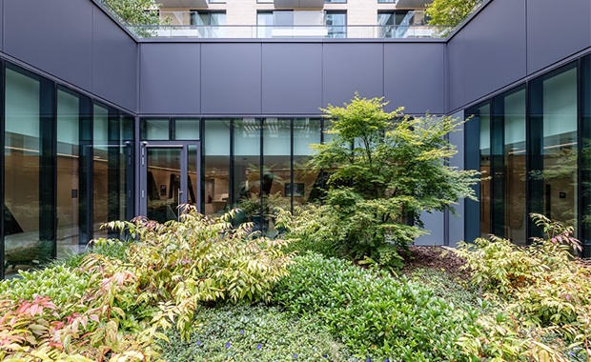
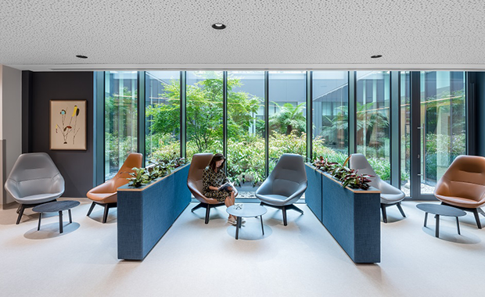
GOODMAN’s FIELDS MEDICAL PRACTICE

Slide 8
Patient Feedback
- Telephone Issues
- Insufficient Staffing
- Customer Service Training
- Building Issues

Slide 9
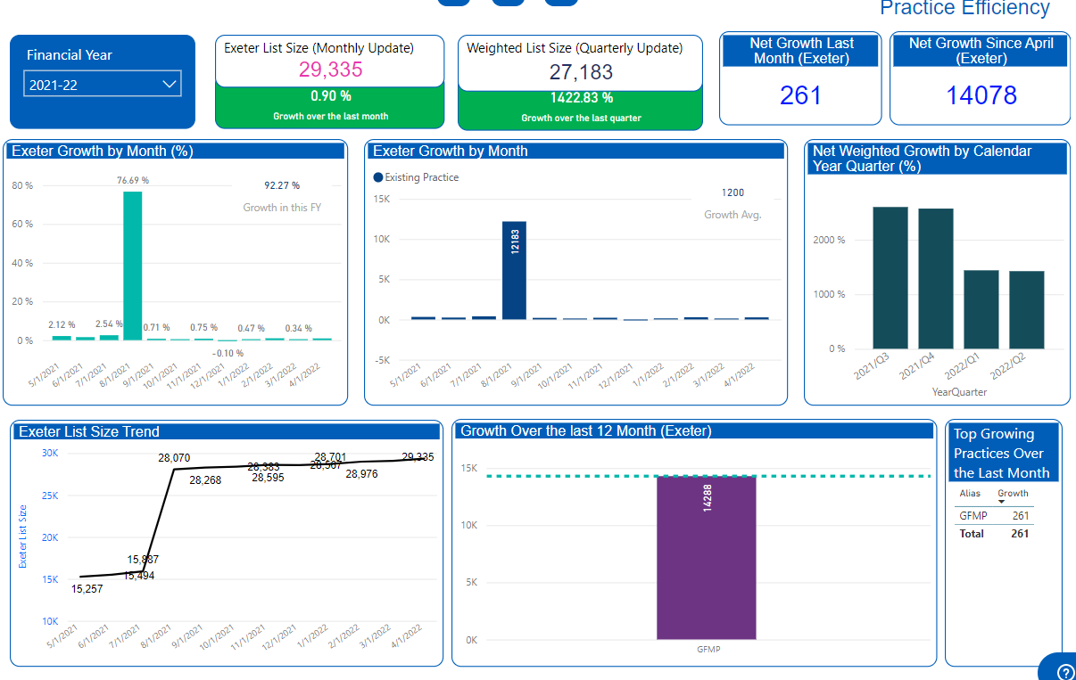
OUR current POPULATION

Slide 10
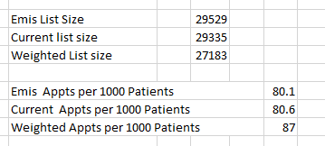
Appointments per 1000 patients

Slide 11
Recruitment
We have recruited the following clinicians to improve our access since the merge and relocation
3 GP’s, they are doing 20 sessions, total of 360 appointment's per week
3 Practice Nurse, they are doing 30 sessions, total of 450 appointments per week
We are in the process of recruiting another GP, 2 HCA’s and 4 reception staff.
We also had a GP return back from maternity leave at the end of June 2022 and she is now doing 2 sessions, total of 36 appointments per week
For our Governance team we have recruited 1 Regional GP, 1 Lead GP and 1 Regional Nurse to support the management team.

Slide 12
Access Funds
We have used ARRS funds to recruit the following
2 Physicians Associate, they do 20 sessions, total of 120 appointments per week
1 Pharmacist who does 10 sessions, total of 75 appointments per week
We are also on the process of recruiting another Pharmacist/PA with the funds
We have used our winter funds to provide extra GP and Nurse sessions to help with access.
We have also increased our enhanced opening hours by offering 12 hours of GP, Nurse and Phlebotomy on Saturday

Slide 13
Prescribing Pharmacist
What can a Pharmacist do ?
Sign Prescriptions
Medication Reviews
Minor Ailments e.g. Sore throat, nail infection etc
Chronic Care Conditions e.g. Diabetes, Asthma, Hypertension
Skin Conditions e.g. Eczema
Contraception
Mental Health
MSK presentations
What can a Pharmacist NOT do ?
Complex cases for children
Neurological presentations
Complex health issues
ACP Trained Pharmacists CAN DO:
Pregnant patients
Dizziness
Abdominal Pain

Slide 14
What is a PA?
A PA (physician associate) is 'a new healthcare professional who, while not a doctor, works to the medical model, with the attitudes, skills and knowledge base to deliver holistic care and treatment within the general medical and/or general practice team under defined levels of supervision.
PA’s work along side GP’s to provide medical care. They have a supportive working relationship with GP’s who are able to discuss cases, give advice & attend to patients as necessary.
Trusted, thoroughly educated & trained healthcare professionals; PA’s are dedicated to expanding access to care and transforming health & wellness through patient-centred, team-based medical practice.

Slide 15
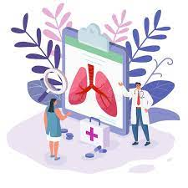
What education does a PA have?
PA’s are educated to the medical model which include both theory and clinical rotations.
They require a bachelor’s in STEM Degrees such as Biomedical science to undertake the training.
Programs are approximately 24 months on average (two academic years). Which equips them with the clinical training to best serve patients.
Clinical rotations include- surgical disciplines, General medicine, gynaecology, paediatrics, emergency medicine and psychiatry

Slide 16
What can PA’s do?
Take medical histories from patients
Performing physical examinations
Diagnosing illnesses
Seeing patients with long-term chronic conditions
Performing diagnostic & therapeutic procedures
Request & analyse test results
Develop & deliver appropriate treatment & care management plans
Organise further investigations, treatment & referral to a doctor/other healthcare professional where appropriate
Provide health promotion & disease prevention advice for patients
They currently can not- prescribe medications or request ionization radiation (cxr or ct scans)

Slide 17
NHS North east London
Update on the building and move
NEL’s Journey of the merge and relocation of two sites
Any questions from patients

Slide 18
Message from the management team
Thank you to everyone for attending the first PPG meeting in the new site. We appreciate your willingness to work together with us to improve the relationship between the practice & our patient community
We hope you are feeling listened to, understood & involved in Practice decisions
We are determined to support our patients with their health as well as their wider social needs
All of us at Goodman’s Fields Medical Practice are committed to empowering our patients to have a healthier and happier future ☺

