Slide 1
Goodman's Fields Health Centre
Patient Participation Group
January 2023

Slide 2
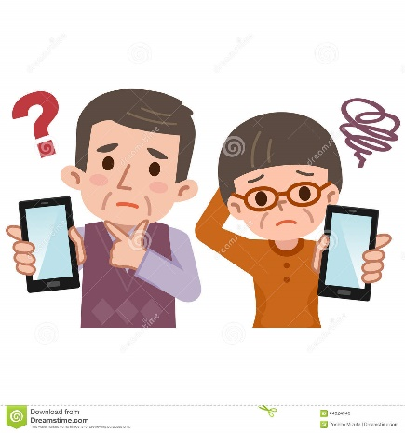
Discussion points
Telecommunications Updates:
Call back system
Automated phone messaging service
Digital Exclusion:
What is digital exclusion?
Thoughts?
Staff Updates:
New admin staff
APM and Senior Admin roles
GP
Appointments:
2 weeks advanced appointments
Hub appointments

Slide 3
Staff Updates:
We have recruited three new admin staff
Awaiting one more to join
APM Mahfuza has left
Zahid and Fharhan have been promoted to Senior Admin roles
Dr Nadina Hussain will be leaving us and her last day is on Friday 27.01.2023
Welcoming new GP Dr Khizar

Slide 4
Appointments
2 weeks advanced appointments are now available to book
4advanced appointment slots per doctor – 12 GP’s through the week
Minimum of 14 slots which is available each day
Increased number of Dr.IQ slots
Re-starting Saturday Clinic as Christmas period is over
Hub appointments available – phlebotomy and nursing

Slide 5
Telecommunications Update:
Call back system – Commenced from 19.01.23
Automated phone messaging system

Slide 6
Digital Exclusion
What is Digital exclusion? Broadly defined, digital exclusion is where a section of the population have continuing unequal access and capacity to use Information and Communications Technologies (ICT) that are essential to fully participate in society
Ways we will communicate with our patient
Importance of updating personal contact details

Slide 7
Calling board
PPG meetings
Identify staff
JRX calling system has been installed
PPG meetings will take place once every four months and in the evening
Name badge and lanyards are being worn by staff at both front desk and around the building

