Slide 1

Goodman's Fields
Medical Practice
Patient Participation Group
July 2023

Slide 2


Slide 3

Appointments:
• Dr iQ Increased
appointments
• Other pathways if no
appointments available
• Appointment Ratio
Telecommunications
Updates:
• Call back system
• Automated messages
Staff
Discussion points
recruitment/promotions:
• Admin staff
• APM & PA’s
• 1st contact practitioner
• Nursing staff
• Clinical Lead GPs
Clinical Roles?
Presentation from
Dr. Abadur Chowdhury
Feedback:
• Drop in sessions for
feedback
• Feedback lead appointed

Slide 4

Staff Updates:
• We have recruited five new admin staff and await three more to join
• APM Shobnom is going on Maternity leave from Friday 28th July 2023
• Zahid has been appointed as new APM
• We have A new first contact physio practitioner
• Two PA’s Taniya and Sadia have been recruited
• Awaiting one GP and two pharmacists to join our clinical team
• We have recruited a Lead Nurse, Yasmin and a Practice Nurse, Habiba
• Dr A Ahmed & Dr T Akinseye have been promoted to Clinical lead GPs

Slide 5

Appointments
• 48 hours and 2 weeks advanced appointments are available to book
• When all appointments are booked on the day, staff will signpost patients to
other pathways such as 111, local pharmacy, Dr.iQ self help and Hub
appointments.
• Increased number of Dr.iQ sessions with Allied Health Care Professionals
through the week. Especially on a Monday due to high demand.
• Hub appointments available – GP, ANP, phlebotomy and nursing
• We offer extended Saturday clinics with GP, Phlebotomist
and nursing

Slide 6
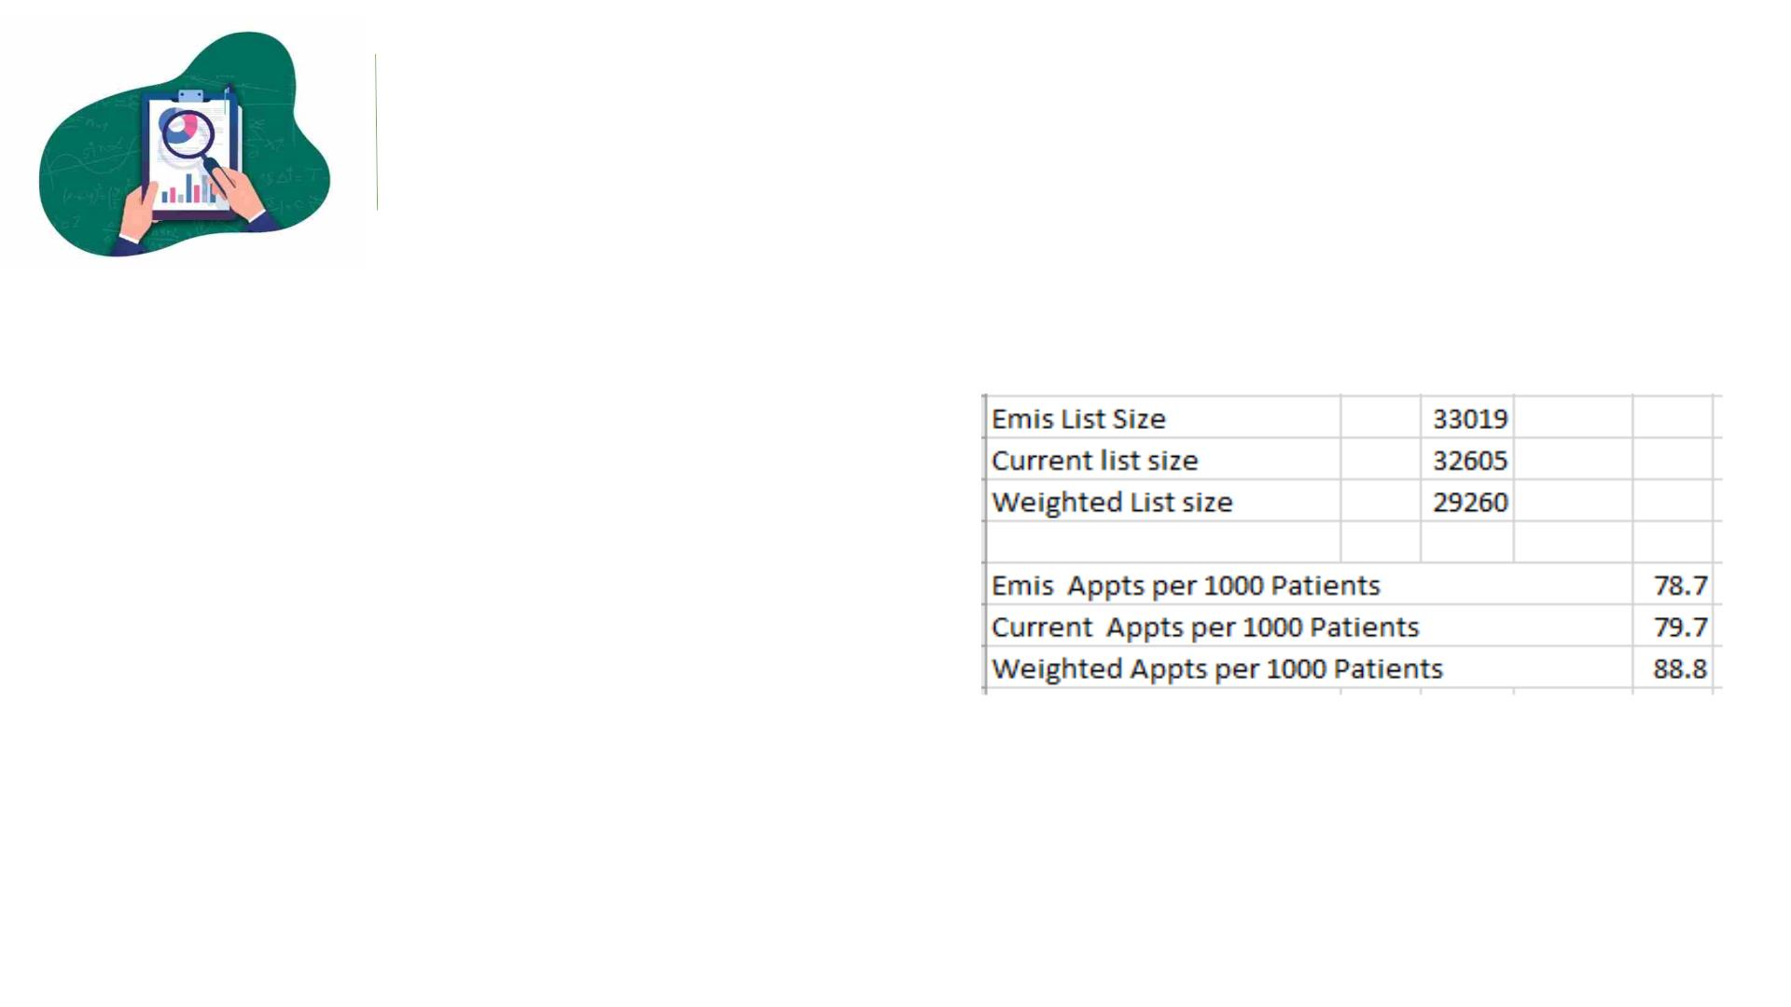
Appointment Ratio
• We are currently offering 88
appointment per 1000 patients
• Contractually, we should be
offering 72 Appointments
per 1000 patients
• We have the following number of clinicians:
Ø 12 GP’s
Ø 3 ANP’s
Ø 4 PA’s
Ø 6 Pharmacists
Ø 1 first contact physio practitioner

Slide 7

Telecommunications Update:
• Call back system – is working well, we
have received good feedback from our
patient. This has reduced waiting time.
• Automated phone messaging system –
Comms team are working on features, it is
not available on our software yet.

Slide 8

Feedback
• Appointed Feedback Leads - Nushrin and Mahfuza
• We will be holding one drop in session every month for an hour, for
patients to raise any concerns, give us feedback so that we can improve
services
• Others ways to give feedback
Ø Feedback box
Ø Speak to a member of staff
Ø Feedback Email/letter
Ø Friends and family test

Slide 9

• Building Temperature
• PPG meetings
• We have raised this with the landlord,
currently under control
• Reminder messages have been sent
along with a call
• Calling Board
• Unable to change pronunciations,
advised by IT
• Personal Details
• We have slips at the front desk, so
patients can write down their details
instead of saying it out loud
• Disabled Bay
• Clinical Roles
• Still waiting on Landlord and NHSP
to update us
• Dr Choudhury will present to you the
roles of each clinician which will play
on our TV in the Patient waiting area

Slide 10

Clinical Roles?
Presentation by Dr. Abadur Chowdhury

Slide 11

GPs are the most senior members of our team and are doctors. They have completed medical school
and at least 5 further years of post graduate training to specialise into becoming GPs.
GPs oversee all aspects of patient care. They meet regularly with other members of the practice
team to plan and co-ordinate patient care. All other staff members work under the supervision of GPs
They can help with:
Our GPs
• Diagnosing and treating
Dr Saffan Qureshi
Dr Aziz Ahmed
health conditions
• Ordering tests and
Dr Taiwo Akinseye
Dr Ana Luna
interpreting results
• Prescribing appropriate
Dr Shaheena Shakoor
Dr Vidaltxo Martinez
Dr Hanson Tang
Dr khizar Khan
medications
• Referring you to hospital
and other services for
urgent and specialist
treatment
Dr Ishi bains
• They are best for
complex medical issues
Dr Ghias Shafi
Dr Yalini Kugatahas
Dr Abadur Chowdhury (ST3
Registrar)

Slide 12

Physician Associates (PAs)are healthcare professionals trained and qualified to diagnose and treat a
wide range of health conditions. Although they are not doctors, they have completed a 2-year post
graduate Physician Associate degree. They work alongside GPs to provide care to patients and are
supervised by GPs at all times to maximise patient care.
They can help with:
Our Physician Associates
Kaoutar Mameri
Basithur Rahman
Taniya Khanum
Sadia Zeb
• Diagnosing and treating
simple and common
health conditions
• Arranging tests and
interpreting results
• Performing physical
examinations
• Best for minor ailments
and common medical
problems

Slide 13
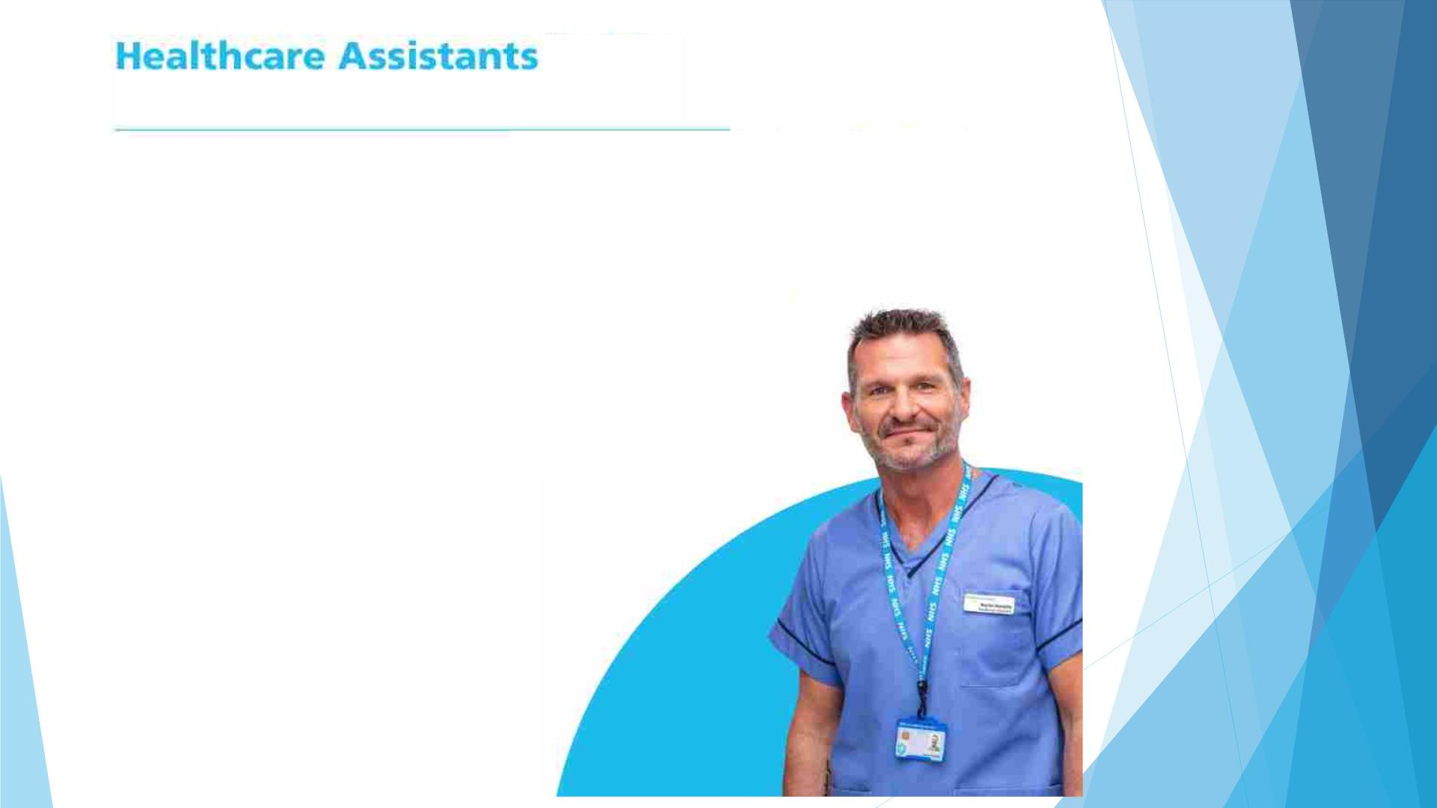
Healthcare Assistants (HCAs) work under the guidance of a nurse or other healthcare professional to
help with routine health checks and provide patients with general health and wellbeing advice.
They can help with:
Our Healthcare Assistants
Comfort Ogba Azih
Sunarun Khatun
• Health checks, such as
blood pressure monitoring
and taking blood samples
• Vaccinations and injections
Jabada Khanom
• Healthy Living advice e.g.
stopping smoking and
weight loss
Reshma Khatun
Rahema Begum
Kete Gibbons
Ali Shuja (Medical Assistant)
Rushna Miah (Medical Assistant)

Slide 14
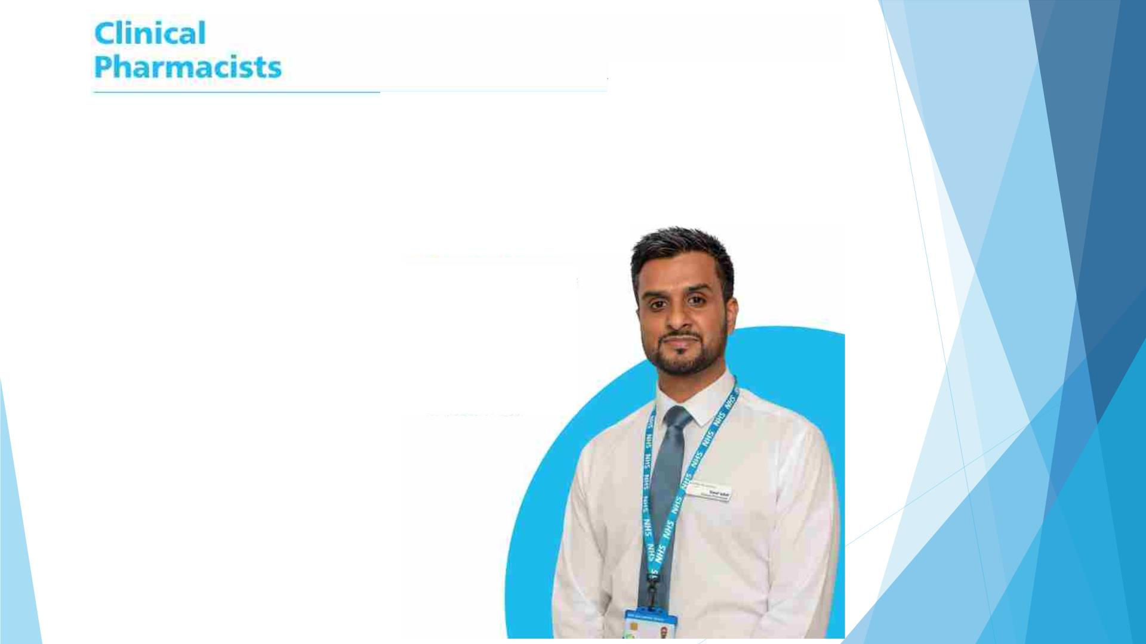
Clinical pharmacists are experts in medicines and can help people stay as well as possible. They
support those with long-term conditions like asthma, diabetes, and high blood pressure or anyone
taking multiple medicines. They work with GPs, Local pharmacies and hospitals and many can also
prescribe medications.
They can help with:
Our Pharmacists
Miten Vadukul
Shahareen Miah
Nadia Rahman
Saidul Islam
• In-depth reviews of your
medicines if you have long
term conditions
• Agreeing and making
changes to your
prescriptions
Anwar Miah
• Advice about medicines and
side effects
Richy Attray
• Advice and care for
Sumaiya Tahseen
Mashfia Sharif
common health problems

Slide 15

Nurses undertake a wide range of roles and are involved in almost every aspect of a patient’s care-
assessing, screening and treating people of all ages. In addition to their traditional roles such as
wound care, immunisations and administration of medications, they run health checks and clinics for
patients with long-term conditions such as asthma, heart disease and diabetes.
They can help with:
Our Nurses
• Vaccinations and injections
Yasmin Din (lead nurse)
Habiba Khanam
Monowara Khan
Chriso Kyriakou
Tahera Begum
• Supporting people with long
-term conditions such as
asthma and diabetes
• Healthy living advice e.g.
stopping smoking and
weight loss
Kenisha Farrell
• Family planning and sexual
health advice including
smear tests
• Wound care and removal of
stitches

Slide 16
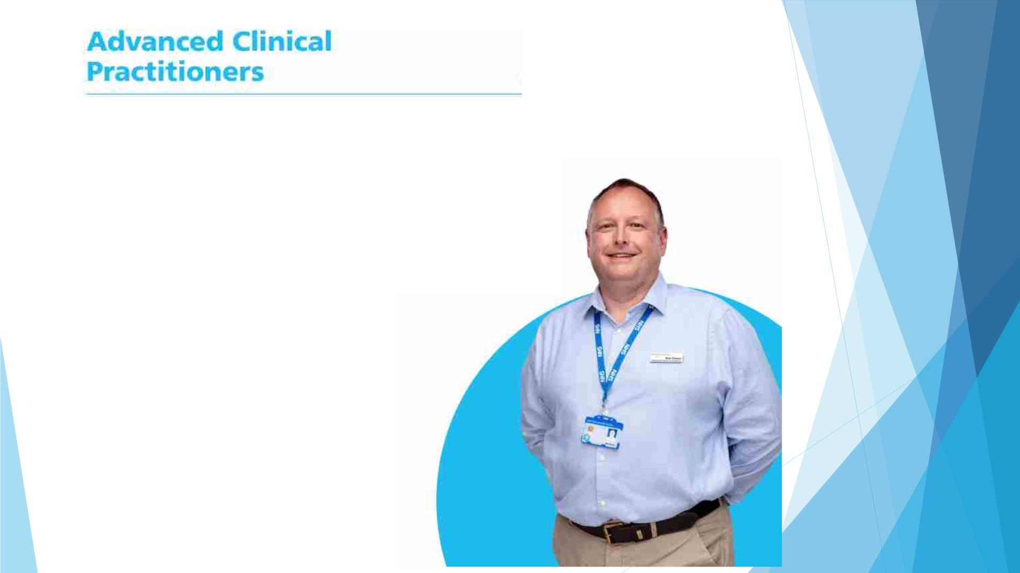
Advanced Clinical Practitioners come from a wide range of clinical backgrounds such as nursing,
pharmacy, physiotherapy and paramedics. They are highly trained and have the knowledge and skills
to manage all aspects of patient care.
They can help with:
Our Advanced Practitioners
Winifred Egemonye
Grace Sodeinde
Saidul Islam
• Diagnosing and treating
health conditions
• Ordering tests and
interpreting results
• Prescribing medication
Anwar Miah
• They are best for minor
ailment and common
medical problems
Richy Attray

Slide 17

Social prescribing involves helping people to improve their health and wellbeing by connecting them
to activities in the community. Link workers (“Social Prescribers”) connect those feeling lonely,
overwhelmed or in in need of help to a range of local support, from community and activity groups to
work, debt and housing advice.
They can help with:
Our Social Prescribers
• Getting people to focus on
their own priorities and the
things that affect their
wellbeing
Mr Muhammad Dobir Miah
• Supporting people to take
more control of their health
• Introducing people to
groups and activities in
their community- for
example weight-loss
programmes.

Slide 18
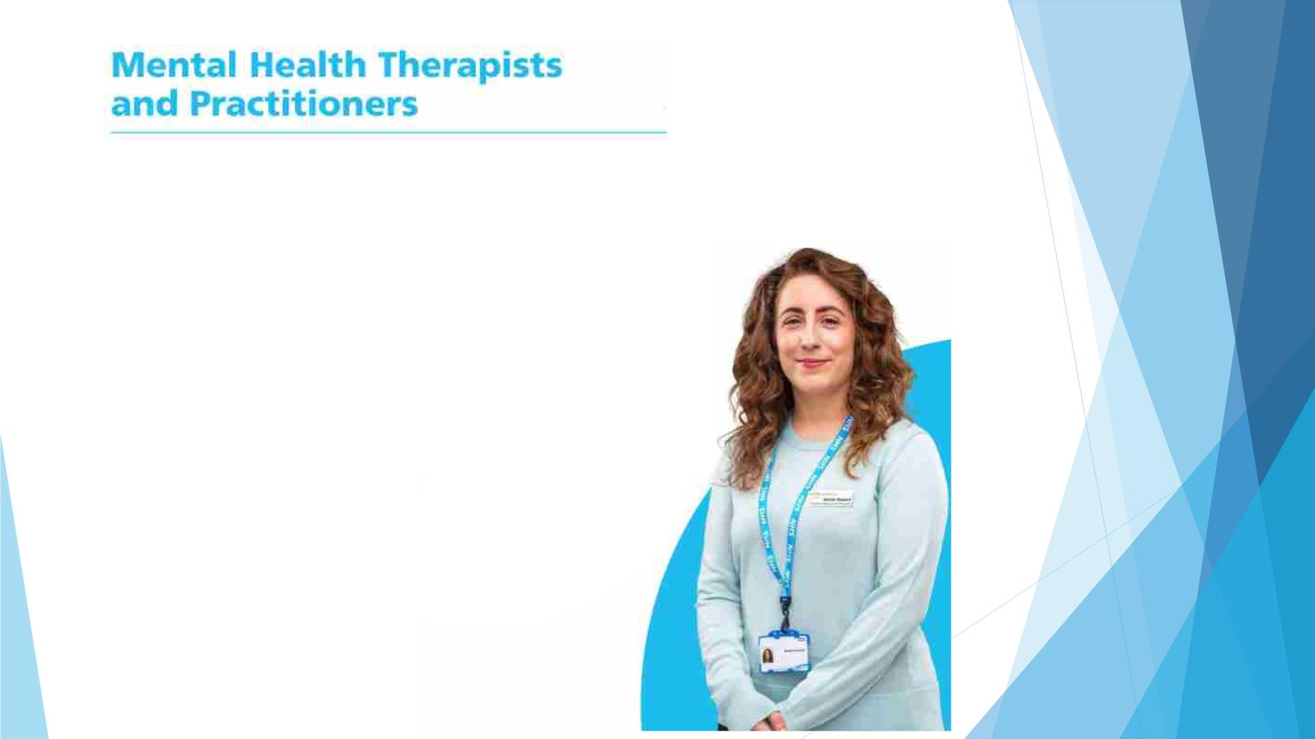
Mental Health Practitioners are specialist nurses who are trained to assess and provide care for
people with various mental health problems such as anxiety, depression and schizophrenia. They
provide follow-up care for patients who may require regular input to manage their mental health.
They can help with:
Our Mental Health Practitioners
Mr Yele Ige
• Assessing symptoms of
mental health problems
such as anxiety
• Suggesting appropriate
psychiatric medications
such as antidepressants
• Assessing the benefit of
those medications
• Discussing your case with
psychiatrists if you may
need more complex care.

Slide 19

First Contact Physiotherapists
First Contact Physiotherapists are experts in musculoskeletal (MSK) conditions. They are able to
assess, diagnose and suggest treatment such as self-physiotherapy exercises for a range of muscle and
joint conditions. Although they cannot provide guided- physiotherapy sessions, they can arrange
access to further treatment, investigations and specialists when needed- including to community
physiotherapists for guided exercises.
They can help with:
Our First Contact Physiotherapists
Ms Kanchi Vyas
• Making a diagnosis by
assessing your joint/
muscle pain and other
related symptoms
• Advising on simple
measures you can take to
help your symptoms
• Arranging investigations
such as ultrasound scans
• Referrals to specialist
services and physiotherapy

Slide 20

Care navigators (reception team) are specially trained to know about the care and services available
to you at your surgery and in your area. They will listen and talk to you in confidence about your
health problem, to understand your needs so they can book you an appointment with the right
healthcare professional or service.
They can help you with:
• Get seen as soon as possible
• Know whether self-referral
is available for certain
services
• Make appointments for new
services or new kinds of
care you may not be aware
of
• Accessing the right
healthcare professional.

Slide 21


